Slide 1
How and why do we need to change our management of peat?
Dr Chris Field
Manchester Metropolitan University

Slide 2
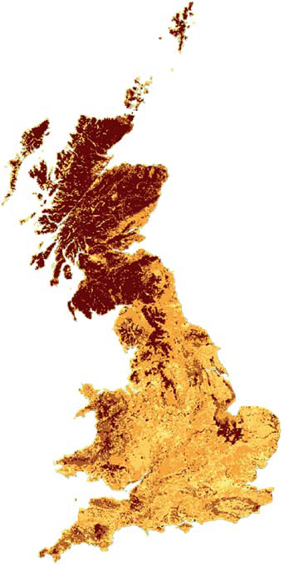

Peatlands and carbon
Carbon density
kt km⁻²
Despite covering just 3% of global land surface, peatlands store approximately 42% of all soil carbon (IUCN, 2017)
In the UK peat covers 12% of land area and stores around 20 years of UK CO₂ emissions
Significant peatlands exist across Lancashire and the north west
Many of our peatlands are degraded due to air pollution, over-grazing, fire and land management
At 6% of man’s GHG emissions, peatland CO₂ losses are twice that of aviation!
0–5
50 –10
10 –15
15 –20
> 20
Bradley et al. 2005
Soil Use and Management 21

Slide 3
Peatlands and Manchester
There are over 12,000 ha of upland peat and over 5,000 ha of lowland peat in Greater Manchester
The estimated carbon storage of Manchester’s peatlands is around 5 million tons (18 million tonnes of CO₂)
Combined they emit over 180,000 tonnes of carbon dioxide every year
A majority of these emissions come from agricultural land
Map showing land use on Chat Moss
Data and map from Smart et al., (2020) GMCA Peat Pilot Report for DEFRA

Slide 4
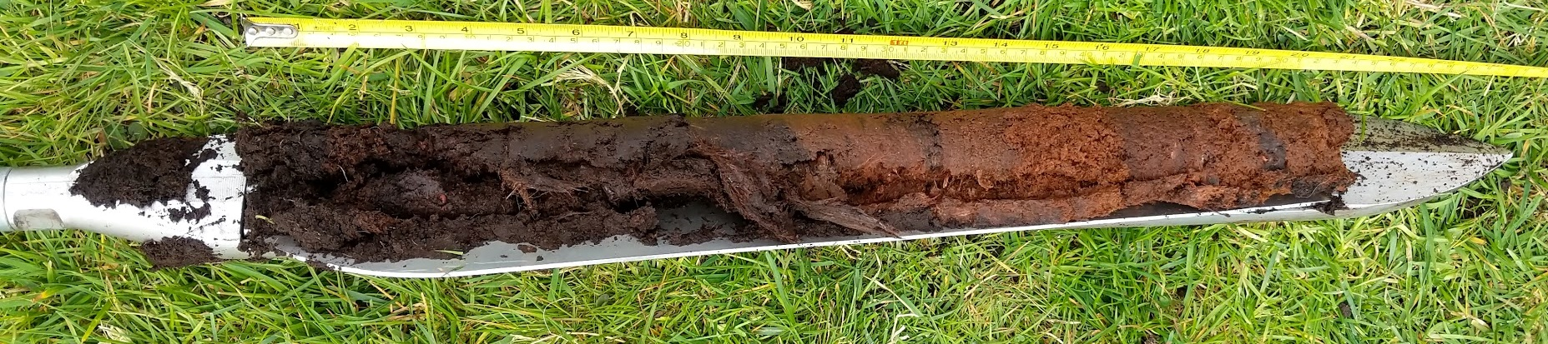
Peatlands store carbon
Peatlands are formed under wet conditions
Plants decompose slower than they grow
When we drain peatlands to use them for agriculture much of carbon stored is returned to the atmosphere
If we re-wet peatlands and add wetland plants this process is halted and they start to actively store carbon from the atmosphere again
To meet our 2038 carbon neutral target we must restore or change the management of between 50 and 75% of Manchester’s peatlands
Winmarleigh Moss , almost 20% of the carbon in the upper soil has been lost since drainage in 1990

Slide 5
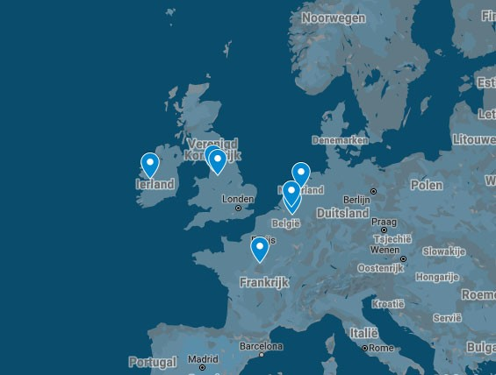
Care-Peat 2019-2022
7 pilot sites across 5 countries
To reduce C-emissions and restore C-storage capacity of different types of peatland
Development of reliable measuring methods and predictive models of C-fluxes in peatlands as base for a decision making tool
Identify sustainable socio-economic models… and policies to promote peatland restoration
Demonstrating new techniques and methods to restore and improve C-sequestration in peatlands
In Belgium, The Netherlands, France, Ireland and United Kingdom

Slide 6
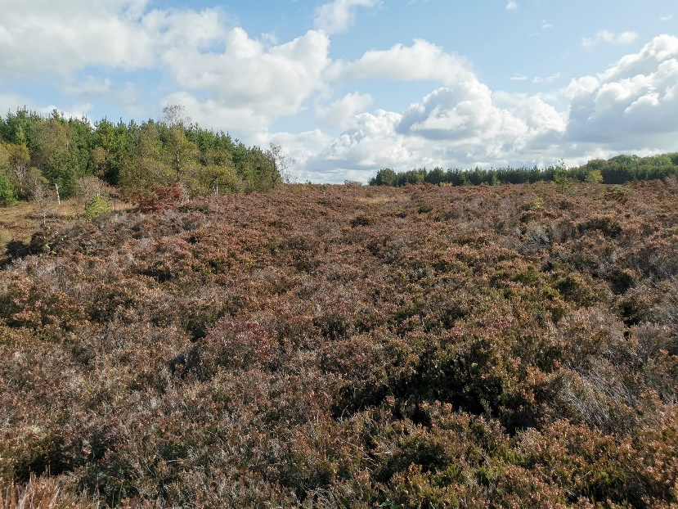
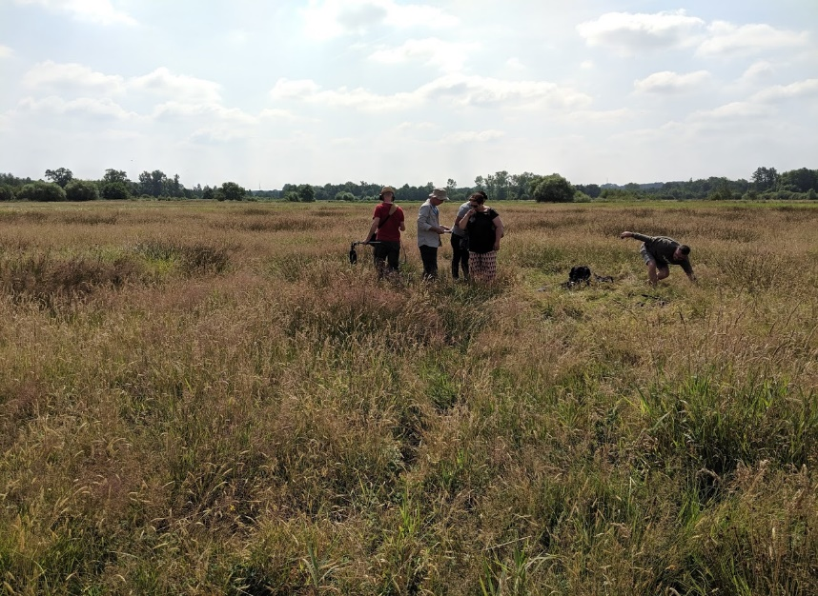
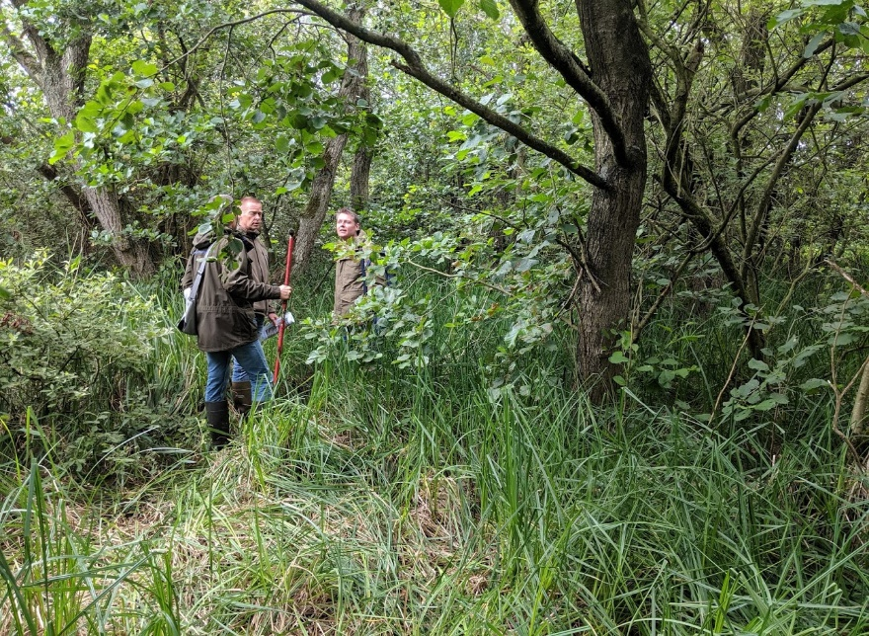
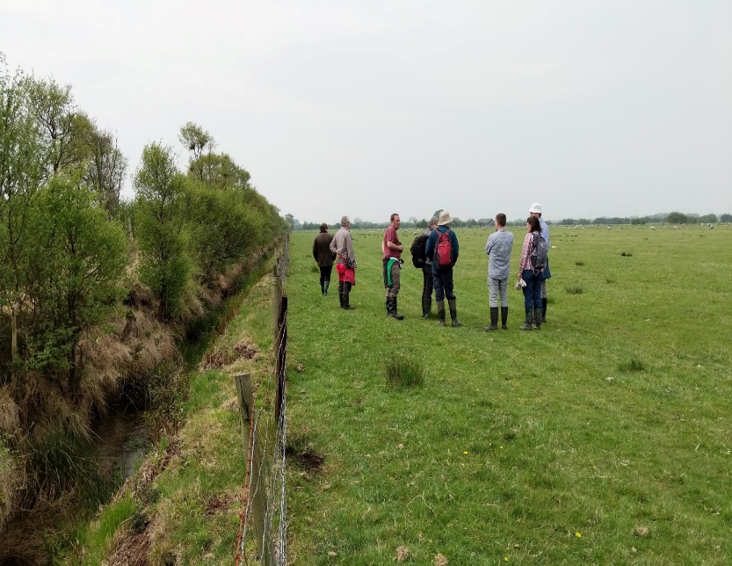
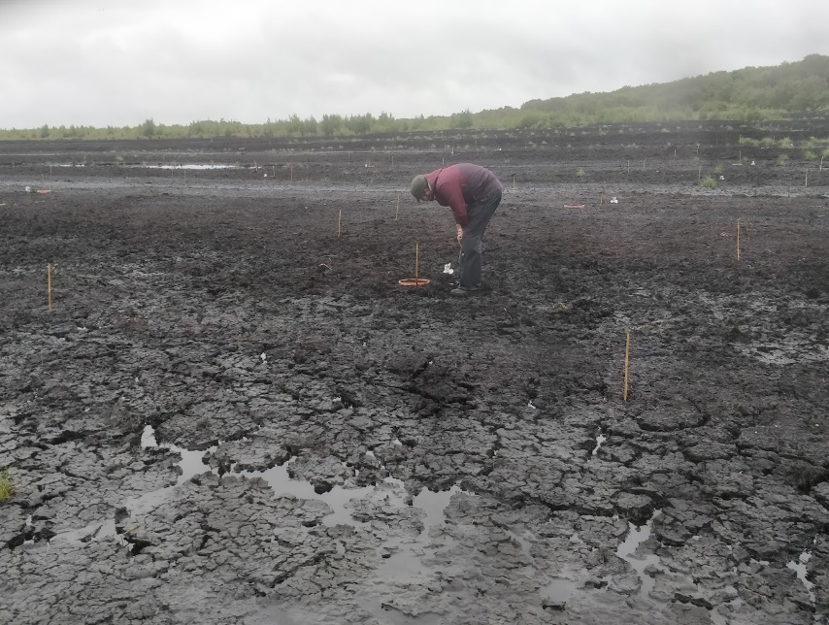
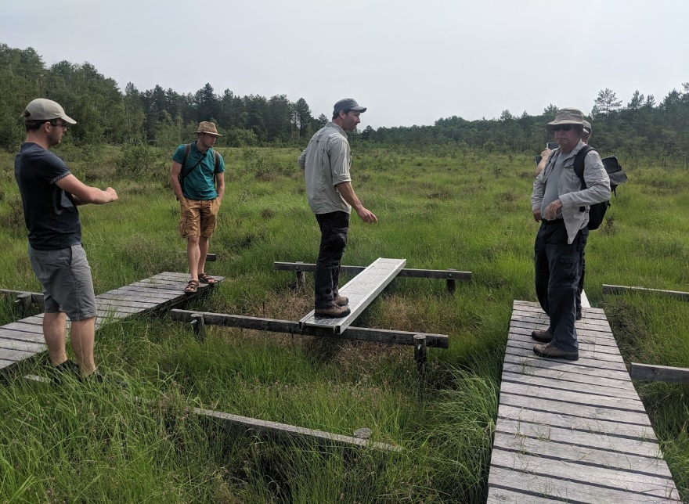
Care-Peat pilot sites – at each we monitor the carbon benefits
Cloncrow Bog, IE
Black Creek, BE
Peat Pits, NL
Winmarleigh Moss, UK
Little Woolden Moss, UK
La Guette, FR

Slide 7
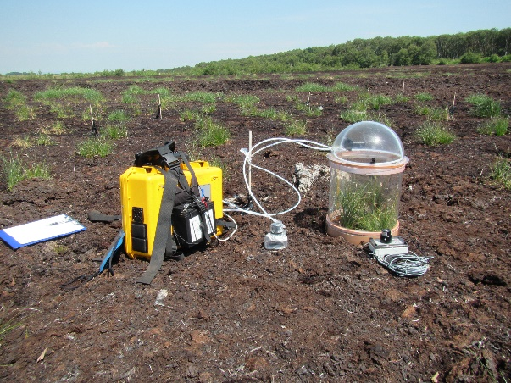
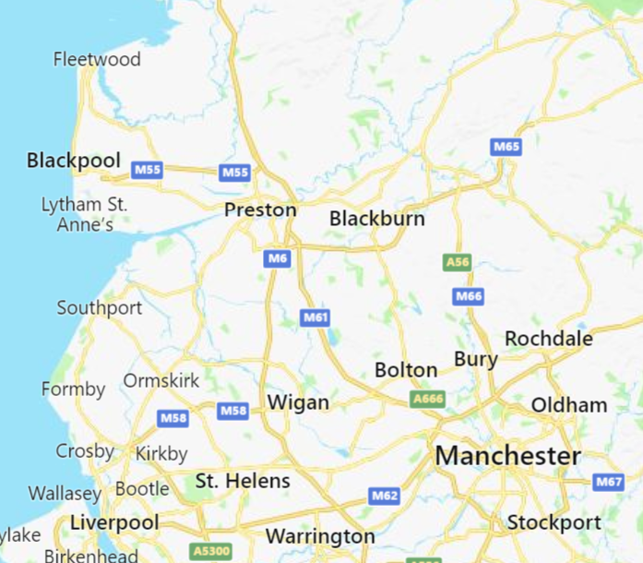
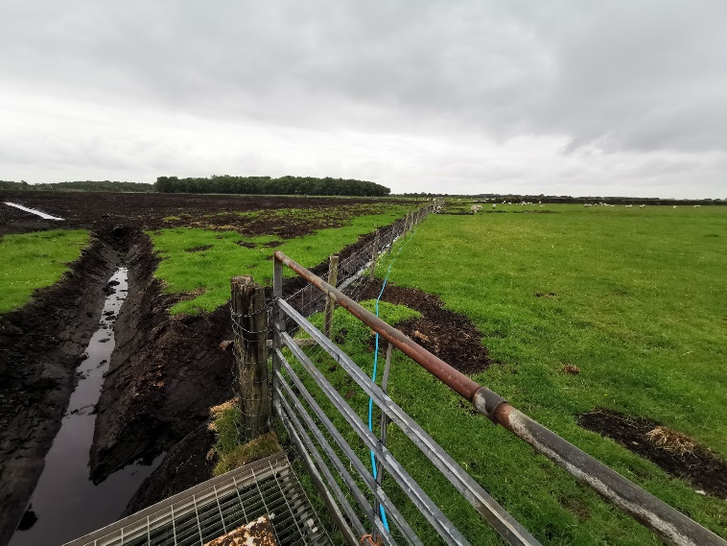
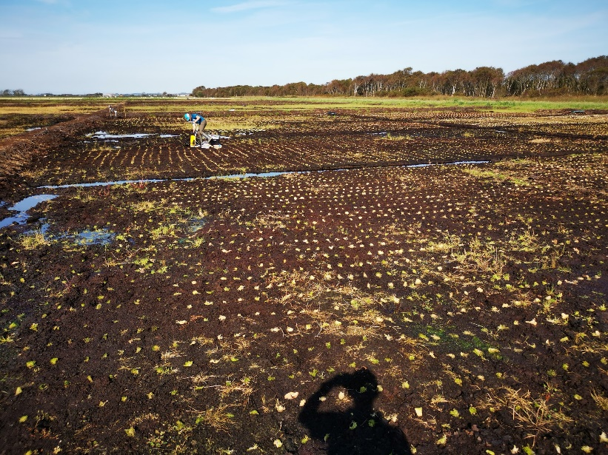
Little Woolden and Winmarleigh Mosses, UK
Restore former extracted peatland with Sphagnum and ‘Companion planting’ to accelerate carbon storage
‘Carbon farm’ on former, drained agricultural land
  Raise water table and plant Sphagnum moss
  Benefits to SSSI from rewetting buffer land
  Demonstration site for carbon offsetting in land

Slide 8
Summary
Peatlands are huge carbon stores
Human pressures and current management means these carbon stores are sources of carbon dioxide emissions
It is ‘easy’ to reduce these emissions but we need the policy and economic enablers
Restoration of peatlands is seen as key in achieving carbon targets

