Slide 1


The Climate Emergency
The role of peatlands – from ambition to action
© Nathan Chandler/ CarePEAT
Emma Goodyer
Programme Manager at IUCN UK Peatland Programme emma.goodyer@iucn.org.uk

Slide 2


NATIONAL STRATEGY
COUNTRY LEVEL ACTION PLANS
POLICIES AND TARGETS
FUNDING AND DELIVERY
UK-WIDE & COUNTRY LEVEL
UK-WIDE & COUNTRY LEVEL
ENGLAND
SCOTLAND
WALES
NORTHERN IRELAND

Slide 3

Funding
Long-term economic stimulus, beyond capital investment
Incentives to maintain healthy peatlands
Utilise existing novel funding mechanisms e.g. Peatland Code and seek opportunities for new schemes (e.g. EU LIFE replacement?)

Slide 4
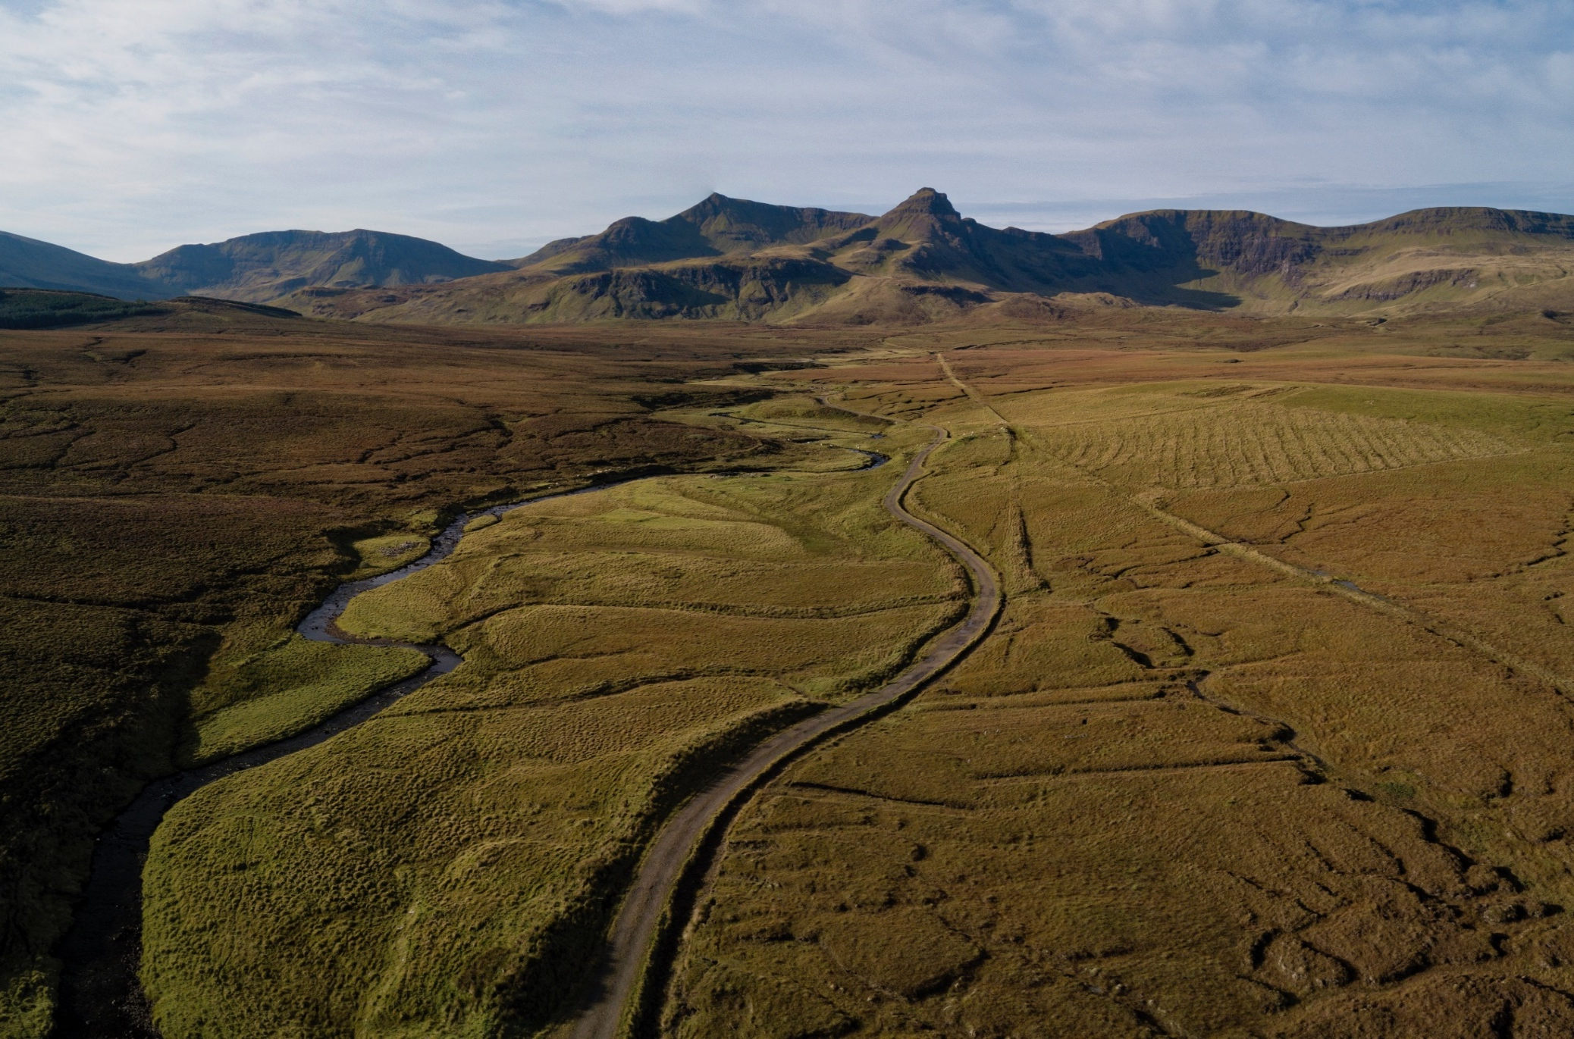
Strategic approach to policy
A strategic, sophisticated overview is needed to resolve conflicts on the ground and deliver the right things in the right place.
Address conflicting land use targets
Notes:
Damage is widespread
Peat extraction- drainage- overgrazing- impacts from infrastructure

Slide 5

Monitoring and reporting
Efficacy of measures?
Impact of funding?
Gains and losses?
International commitments

