Slide 1
Current state of play: peatland policy, strategy and action
Sarah Johnson, Lancashire Peatland Initiative Project Manager,
The Wildlife Trust for Lancashire, Manchester & North Merseyside.
Notes:
One of the activities for Care Peat has been working with our project partners to review existing peatland policies and strategies in north west Europe
The first part of presentation will be presenting a roundup of the finding of the UK chapter of this review
I’ll also be outlining some of the key actions and activities currently underway to deliver against those policies and strategies.
I am going to mainly give overview of those relevant to England only and also policies relating to Greater Manchester and Lancashire (since this is where our care peat pilots are)
Apologies, some of you will already be well versed in this and for the less uninitiated it will be a whistle stop tour – I’d refer you to the summary doc we circulated before the workshop
After this, it will then be for you, the participants to decide, if and where there are gaps in existing policy and what actions we might need to drive further change.

Slide 2

Strategy
European
Legislation
Regional
Climate
Planning
Devolved
Carbon trading
Natural Capital
UK peatland policy is complex!
National
International
Brexit
Biodiversity
Environmental
Agriculture
Notes:
From Chris’s presentation, the benefits of rewetting peatlands for climate change, water, and wildlife are clear.
Is current UK policy? No, its quite complex!
Peatland use in the UK has been highly influenced by a complex set of subnational, national, EU and international policies.
There are no specific peatlands policies for the UK as a whole and there is no single authority responsible for peatland policy at national level; this is largely due to the overlapping interaction of peatland habitats with a range of land uses and policy areas (e.g. water and climate change).
a joint Ministerial Statement of Intent was issued in 2013 by all four nations of the UK, committing to enhancing the natural capital represented by peatlands.
Some overarching policy targets at UK level geared towards the enhancement and sustainable management of peatlands -
BUT The most relevant government policy areas relating to peat are almost entirely devolved to the four UK administrations, which determine the priorities, how funding is allocated and detailed policies for peatland in each region
Also Brexit:
most of the UK's environmental laws and policies are based on European laws. These include water quality, air quality, waste, nature conservation, environmental damage and climate change
still several uncertainties about the final shape new UK post Brexit policies impacting our peatlands will have –
What is clear though, the increasing awareness of climate and biodiversity emergencies, is driving policy to mitigate them much higher up the agenda;
For example: 2019 saw all four devolved governments across the UK declare a climate emergency; in the 2020 Budget speech Sunak 2020 pledged £640 m for a new ‘Nature for Climate Fund’ to support natural habitats like peat bogs
Enough policy support in place?

Slide 3





International obligations
Notes:
UK is one of the world’s major peat nations, and is signed up to International climate change, biodiversity, water and environment obligations which recognise the importance of peatlands.
UN Framework Convention on Climate Change (UNFCCC)
Aichi Biodiversity Targets: Strategic Goal C – Target 15
Requires conservation and restoration of peatlands, highlighting their role in mitigating and adapting to climate change as well as supporting rare and threatened wildlife.
United Nations (UN) Convention on Biological Diversity
Kyoto Protocol international treaty signed 2005- world’s first international agreement to control and reduce greenhouse gas emissions.
Agreed that carbon savings from rewetting drained peatlands, and other forms of peatland restoration, may be used to meet emissions reduction targets
UN Sustainable Development Goals (SDGs)
E.g SDG15: Life on land; includes -halt and reverse land degradation, halt biodiversity loss.
Ramsar Convention on Wetlands
One of latest resolutions from 2015: Peatlands, climate change and wise use: Implications for the Ramsar Convention.
IUCN World Conservation Congress: peatland resolution (Hawaii 2016)
Resolution 043: Calls for action to protect, restore and sustainably manage peatlands.

Slide 4
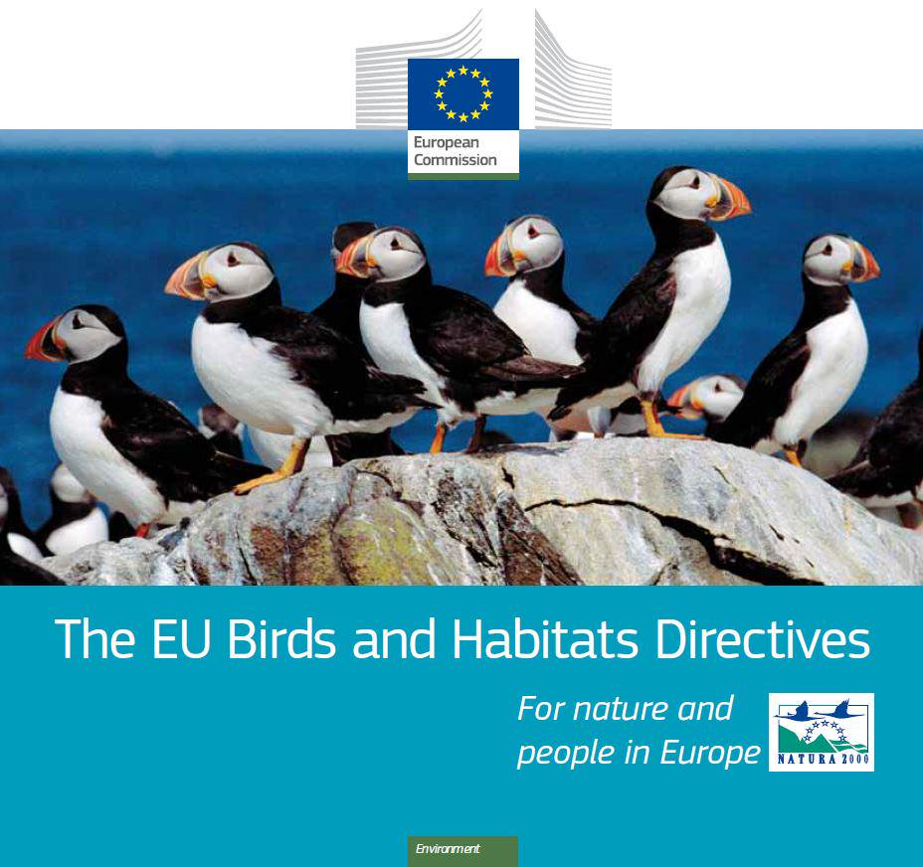
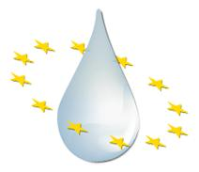
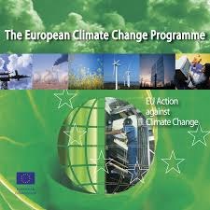



European policy drivers
Notes:
The European Union framework for UK land management funding and policy has had a major impact on our peatlands conservation and restoration activity,
whilst Rural Development Programme funds, such as the Common Agricultural Policy, have been a mainstay of support for peatland management – and also included incentives that harmed peatlands
Other EU policies such as the Birds and Habitats Directives, Water Framework Directive, EU Climate and Energy Framework have steered UK policies relating to our peatland habitats
But No longer part of the EU or CAP post Brexit
The Conservation of Habitats and Species (Amendment) (EU Exit) Regulations 2019 pull current environmental regulations underpinned by EU law across into national law
Still several uncertainties about the shape of post Brexit policies - for example, the new Environmental Land Management System (ELMS) which will underpin agri-environment funding, won’t be fully in place for several years and the new Agriculture and Environment Bills are being debated.

Slide 5
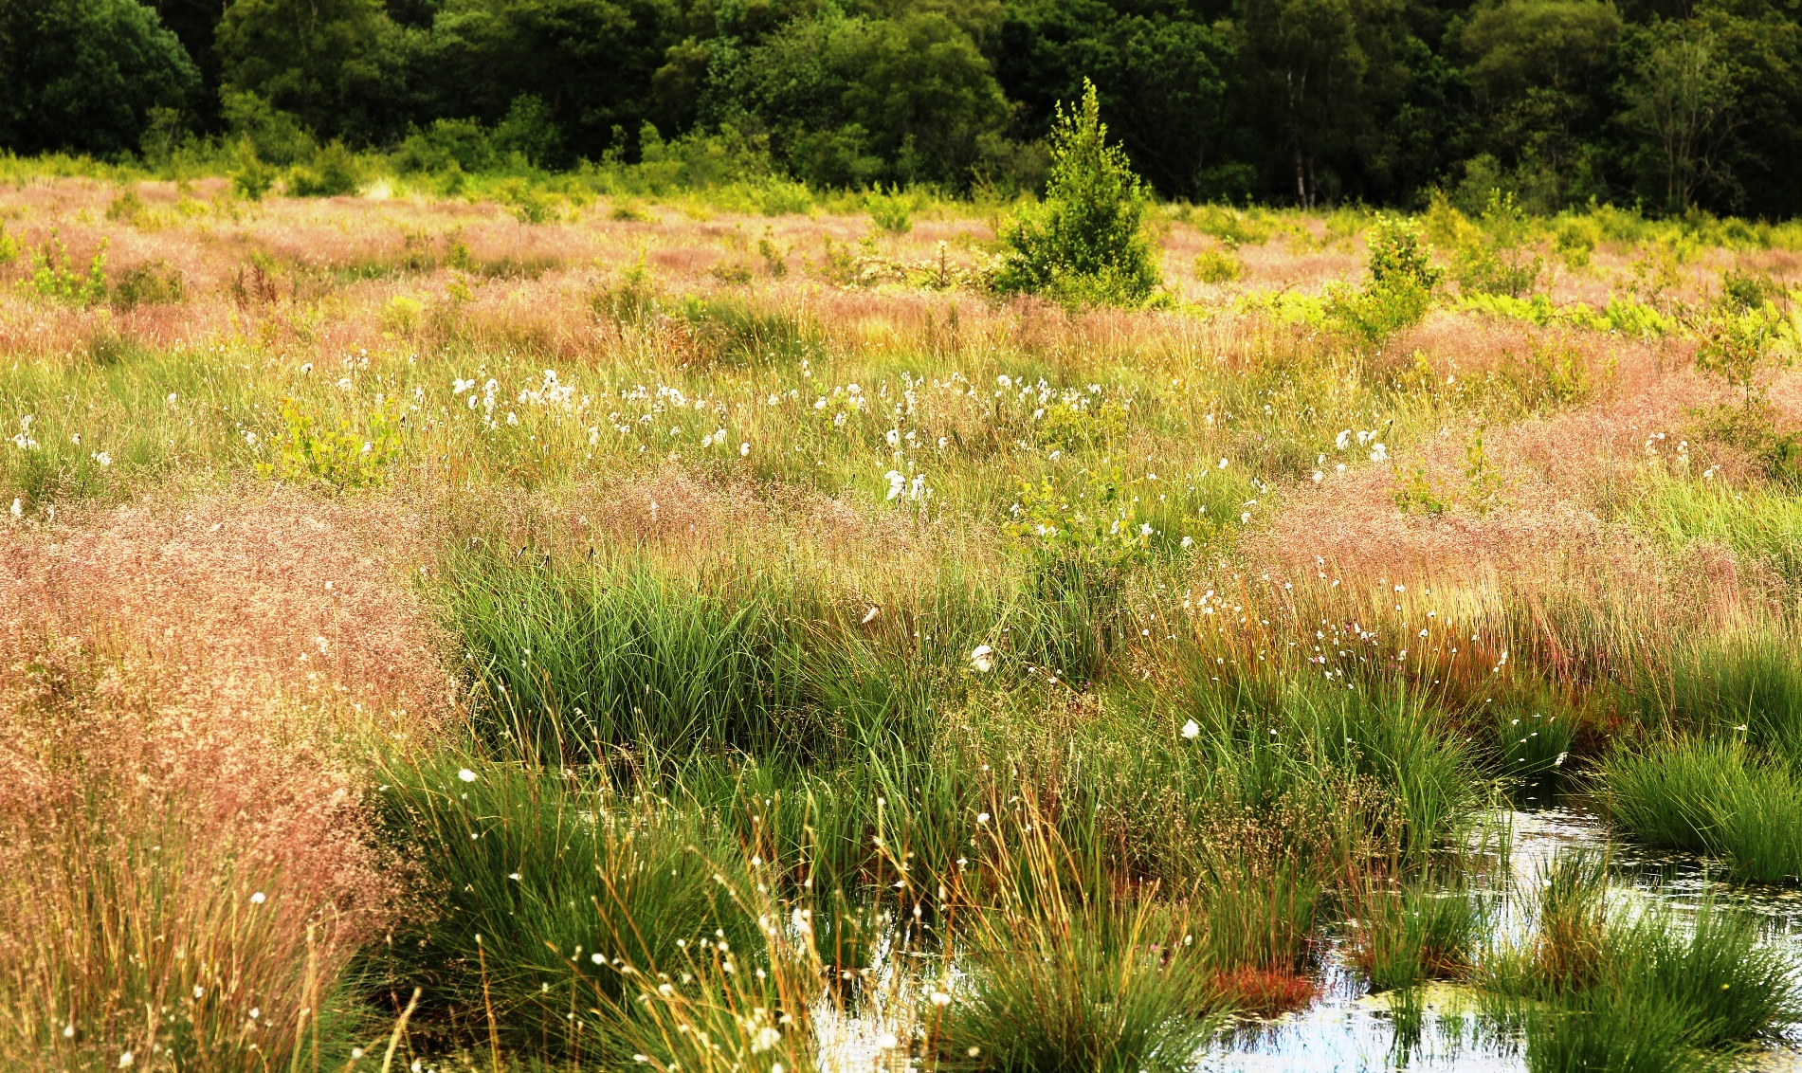
Policy and legislation in England
Protection/ Conservation:
  Statutory area designations (e.g. SSSIs)
  National Planning Policy Framework
Funding for peatland restoration
  Through current voluntary agri-environment schemes
  Can be conflicts between restoration and other land management practices
  Government-level (Defra) grant schemes (e.g. £10million in 2017)
Climate legislation - Climate Change Act 2008
  Set emissions reductions targets BUT does not include formal recognition that peatland play a important role in reaching targets
Notes:
Protection/conservation:
Government provides protection for peatland habitats through statutory area designations, such as Sites of Special Scientific Interest (SSSIs) and Areas of Outstanding Natural Beauty (AONBs) as well
National Planning Policy Framework e.g states that local authorities should not grant further planning permission for peat extraction.
Funding:
restoration activities are now receiving significant levels of more targeted funding, through policy instruments specifically aimed at delivering peatland restoration and research – for delivering climate, water and biodiversity benefits
Currently Government also provides specific incentives for peatland restoration centred on voluntary enrolment (rather than regulatory obligations)
, either through agri-environment schemes, and/or parallel, peatland-specific programmes.
In some cases, there are conflicts between peatland restoration and some land management practices. which in some instances can be detrimental to the condition of peat and the public goods which healthy peatland habitats can provide.
Climate
The UK Climate Change Act (2008), set emissions reductions targets for the UK and DA’s,
government has a legal duty to reduce greenhouse gas emissions by 80% below 1990 levels by 2050
Gov required to set out a series of five year carbon budgets to do this
Latest one, 5th budget included recommendation for adopting more sustainable land management practices, particularly in the case of peatland habitats
BUT does not include formal recognition that peatland restoration and optimal management can play a significant role in achieving these targets, in part because emissions from degraded peatlands have not yet been fully considered in national emissions accounting.

Slide 6

A Green Future: 25 Year Plan to improve the Environment
Specific peatland objectives include:
Improving soil health, restoring and protecting vulnerable peatlands
Ending peat use in horticultural products by 2030
Create and deliver a new ambitious framework for peat restoration in England to ensure all of our peatlands are functioning for the needs of wildlife and people by 2030.
Notes:
Launched in 2018
Specific to peatlands the objectives include:
improving soil health, restoring and protecting vulnerable peatlands
ending peat use in horticultural products by 2030
create and deliver a new ambitious framework for peat restoration in England to ensure all of our peatlands are functioning for the needs of wildlife and people by 2030.
The 25YEP is not that specific on what constitutes vulnerable peatlands, but it does imply this covers all unsustainable peatland use, for upland and lowland.
and 25YEP sets out the intention ‘Where it is not appropriate to restore lowland peat, we will develop new sustainable management measures to make sure that the topsoil is retained for as long as possible and greenhouse gas emissions are reduced’.
but there is no indication of what the balance might be between the restoration or sustainable management

Slide 7
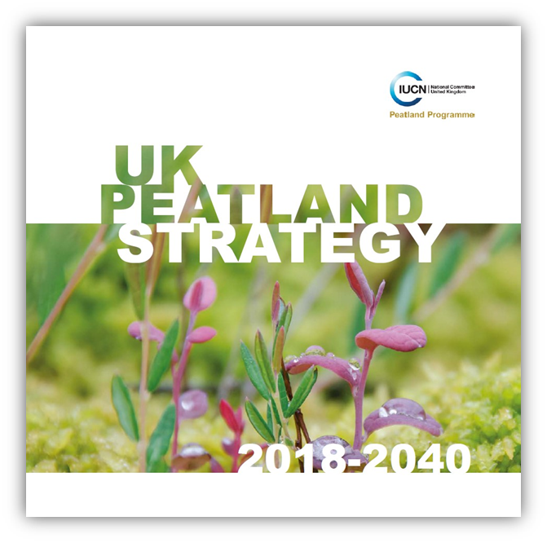
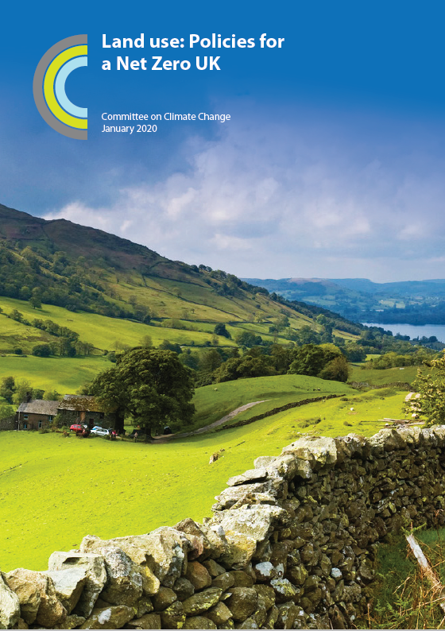
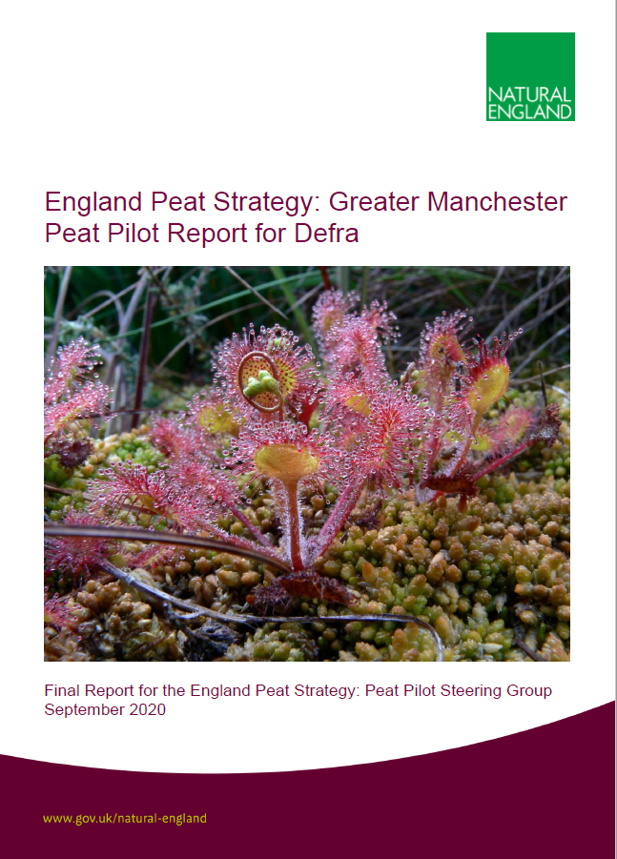
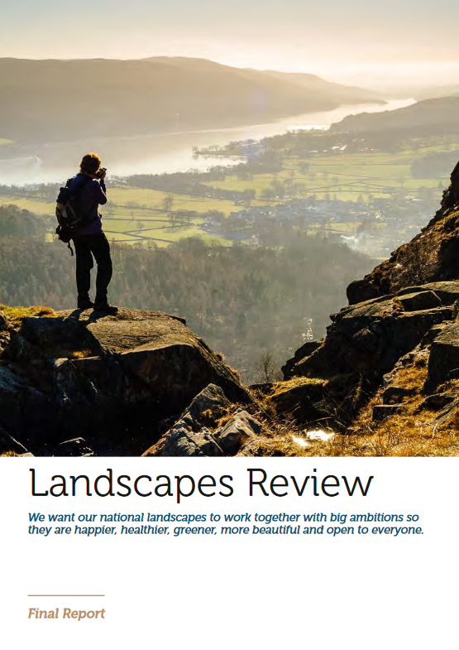
Key policy and strategy reports
Notes:
Committee on Climate Change Report on Land Use: Policies for a Net Zero UK published in (2020):
In-depth advice on UK agricultural policies
Five objectives for new policy, including restoring at least 50% of upland peat and 25% of lowland peat.
Landscape Review final Report (2019) An independent review commissioned by government into whether the protections for National Parks and AONBs are still fit for purpose. Peatland makes up about 15% of National Parks and 18% of AONBs. The report says “peatland restoration should be a priority for all National Parks and AONBs that contain it given the multiple natural capital benefits it provides.” Includes proposals that would benefit peatlands and
The IUCN UK Peatland Programme,– launched their ‘UK Peatland Strategy’ in 2018. with it’s ambition to see 2 million hectares of peatland restored by 2040. This is not a Government target, but is consistent with the 25YEP outcome
Hot off the press – report for one of the 5 peat pilots designed to inform the development of the England Peat Strategy – the Peat Pilot for Greater Manchester
Total emissions around 180,000 t CO2-eq yr from peatlands in greater Manchester , equivalent
to 114,000 return flights form Manchester to New York

Slide 8
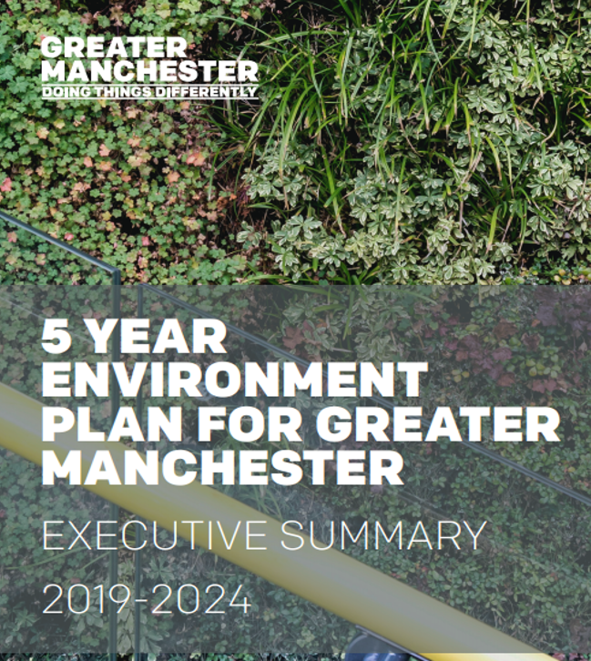
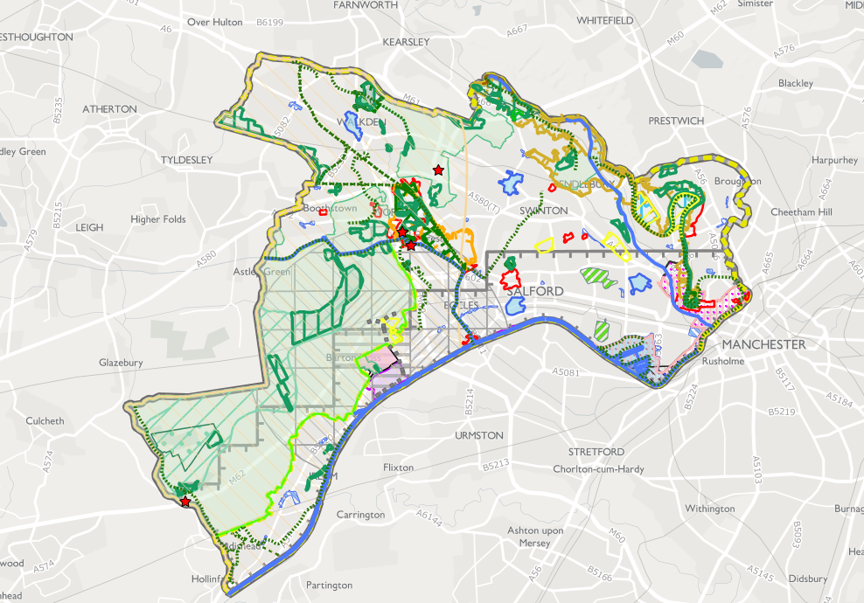
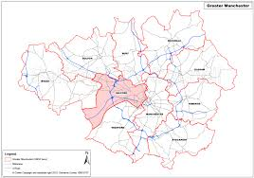

Regional Policy: Greater Manchester
The Salford Local Plan
Notes:
Regional policies and strategies covering the areas of the pilot sites
Upland and Lowland Peat is widespread across the urban city region of Greater Manchester.
The Greater Manchester Combined Authority (GMCA) has produced a 5-year Environment Plan, launched in March 2019. It sets out a long-term aim to be carbon neutral by 2038 and the urgent actions needed in the next 5 years to help achieve this.
Modelling estimated that between 50% and 75% of Greater Manchester’s peatlands would need to be ‘restored’ if the city region is to achieve its aim of net carbon neutrality by 2038.
Includes policy actions directly or indirectly linked with peatland restoration, such as Support of peatland restoration as part of Resilience Strategy
More locally, there is a local plan for Salford where one of our pilots is located
The Salford Local Plan: Development Management Policies and Designations (SLP: DMP) sets out how Salford should develop up to the year 2037 and contains a number of policies and targets relating to biodiversity and climate change. (e.g. maximising carbon sequestration, including by securing the restoration of lowland raised bog, particularly within the Biodiversity Heartland in Chat Moss).

Slide 9

Regional Policy: Lancashire
Lancashire Climate Change Strategy 2009-2020
Lancashire Green Infrastructure Strategy (2009)
Landscape Strategy for Lancashire (2000)
Local Plan for Lancaster District 2011-2031
Notes:
Lancashire
The Care-Peat Winmarleigh Carbon Farm is on four hectares of farmland in Lancashire. Almost one quarter of Lancashire is designated as Green Belt, the bulk in the South and West of the county, areas facing significant development pressures.
Not come across any policy or strategy the relates to peatlands beyond 2020
Lancashire Climate Change Strategy 2009-2020
Covers Lancashire’s key objectives for adapting to climate change and also outlines supporting actions towards the overall vision (e.g. manage Lancashire’s upland and lowland peat lands to sequester carbon and prevent its release).
Acknowledges that land use, and changes in land use, can be responsible for both carbon dioxide emissions and absorption, and that in Lancashire, much of the emissions from land resulted from the drainage of lowland peat for agricultural use.
Lancashire Green Infrastructure Strategy (2009)
Objectives include ‘adapting to and mitigating the effects of climate change’. Also sets out some key interventions including maintaining peat bog resources and using indicators such as carbon storage through peat restoration as a way to assess benefits contributing to the adaption and mitigation of climate change.

Slide 10






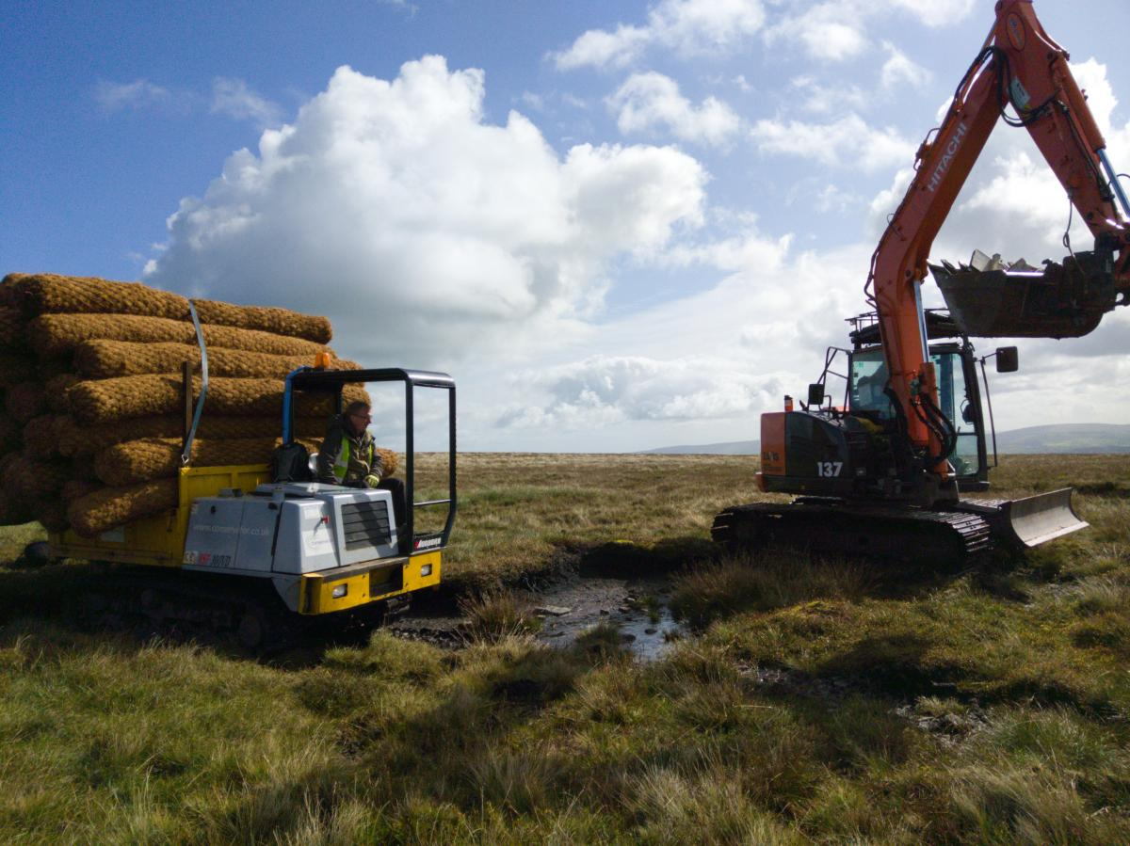






Current State of play: Action
Partnerships
Funding – UK, EU , public, private & 3rd sector
Restoration for carbon, biodiversity, water
Alternative land management
Regional peat partnerships across upland and lowlands
Rivers Trust and Catchment Based Approach (CaBA) partnerships
Notes:
What actions and activities currently underway on our peatlands to deliver against the policies and strategies I have outlined?
Individual organisations and Partnerships across the UK have and continue to deliver often large scale, peatland restoration. - the UK has gained international recognition and seen to be leading the way for other peatland nations.
Regional peat partnerships
Moors for the Future Partnership
Yorkshire Peat Partnership
Cumbria Peat Partnership
Lancashire Peat Partnership
Rivers Trusts and catchment partnerships

Slide 11
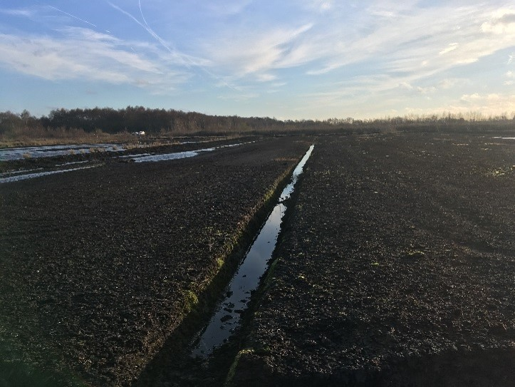


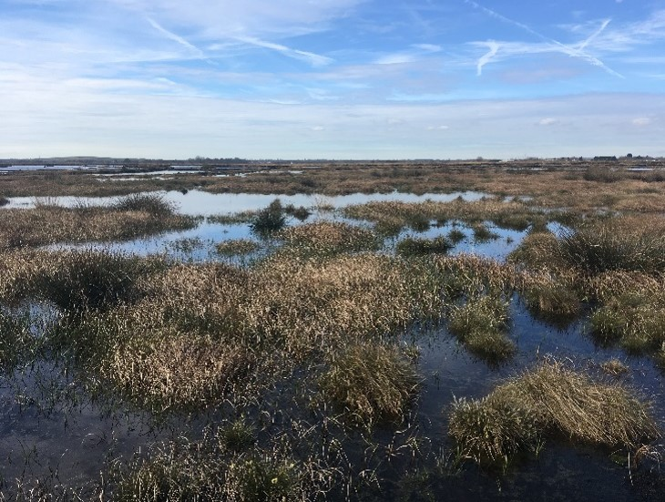


Current State of play: Action funding
Defra biodiversity spending, EU spending and NGO spending accounts for over £476 million per year
Notes:
Funding that action: comes from public, private and 3rd sector funding
Within the UK, Defra biodiversity spending, EU LIFE spending and NGO spending accounts for over £476 million per year (RSPB, 2018) spent on peatland restoration
UK Governments e.g, Defra’s £10M investment in peatland restoration in 2017-18
The North of England Peat Partnership - 394 ha of lowland raised bog and 1679 ha of blanket bog across 21 peatland sites in the north of England.
Moor Carbon - in the Peak District National Park, West Pennine Moors SSSI, and Rossendale Gap - over 2,000 hectares of blanket bog.
EU LIFE: Since 1994, EU LIFE has provided over £32 million in matched funding to repair and manage UK peatlands
Pennine PeatLIFE
MoorLIFE Project
Interreg North West Europe projects
CarePeat - - Restoring the carbon storage capacity of peatlands
Cconnects - aims to reduce the high carbon footprint of peatland soils in Northwest Europe by introducing new bio-based business models developed for sustainable land management practices.
Canape - Creating a New Approach to Peatland Ecosystems
NGO – e.g my project within LWT is funded by Esmée Fairbairn Foundation, one of the largest independent grant-making organisations in the UK.
Private sector funded peatland restoration is also established - most particularly management of water quality and quantity from peatland in water catchments. E.g United Utilities - sustainable catchment management programme (SCaMP)

Slide 12
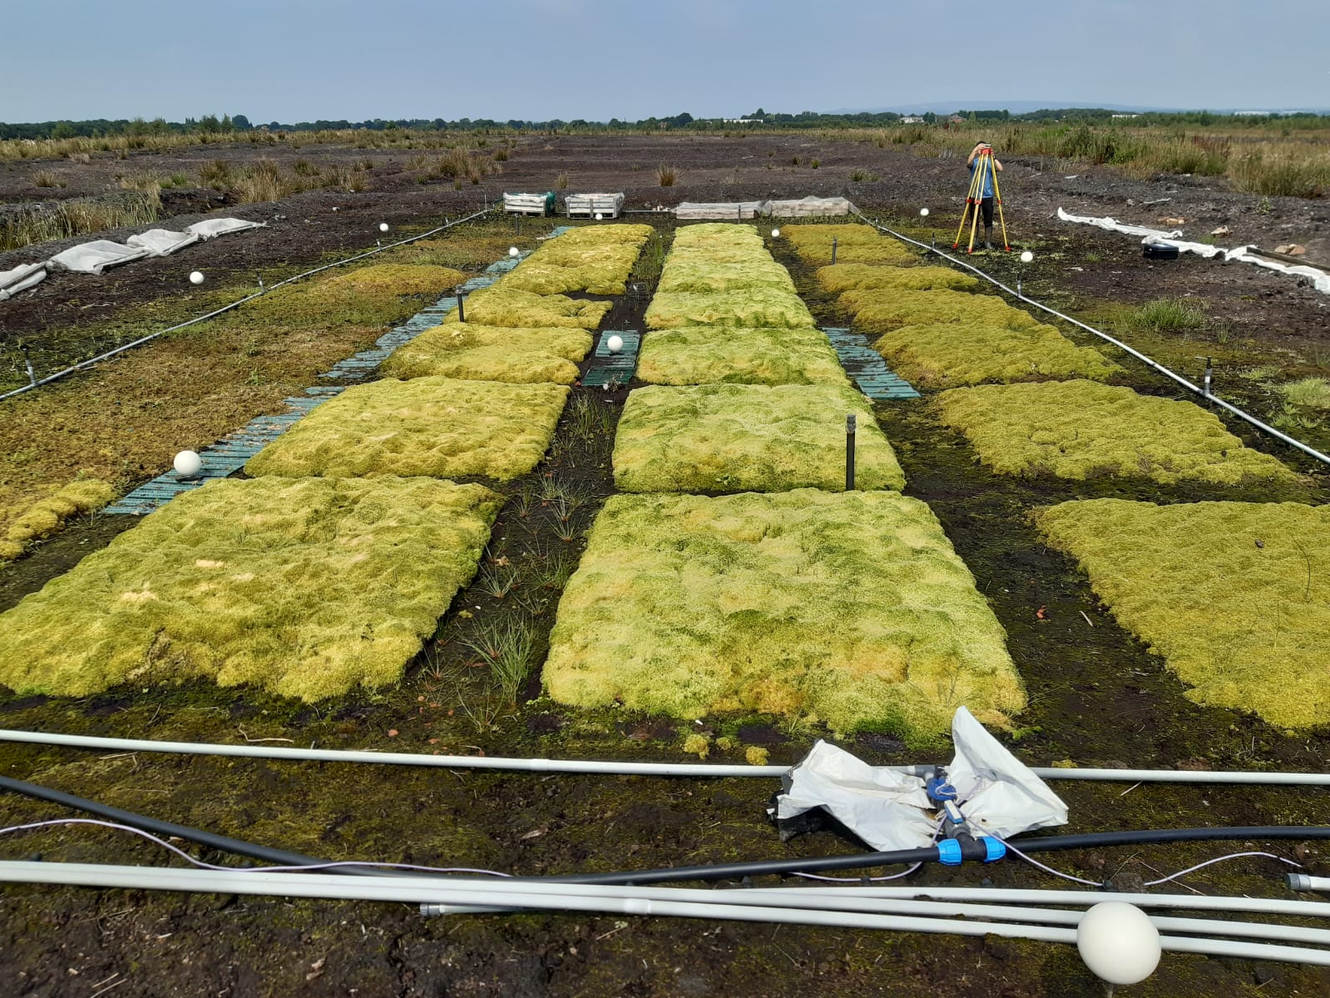


Current State of play:
alternative land management
Project Name | Areas Investigated
Sphagnum Farming UK - A Sustainable Alternative to Peat in Growing Media | Sphagnum cultivation.
Waterworks Project | Typha, Reed, Sphagnum, Glyceria and other cultivation
Wetland Conservation Biomass to Bioenergy | Biomass production for energy – Reed, Typha, Fen biomass.
CANAPE project / Hickling Broad | Converting surplus materials from conservation management into commercial products – reed and sedge.
Sphagnum Farming UK – Innovate UK
Notes:
Restoration of peatlands is not always practical or feasible, so action is not just about restoration but also looking at alternative wetter land management of peatlands
Increasing number of trials in this area in the UK
E.G our Care Peat carbon farm
Sphagnum Farming UK – Innovate UK: This project seeks to establish a method for growing Sphagnum moss on a large scale to provide a sustainable alternative to peat in horticulture.
Paludiculture is explicitly mentioned as a sustainable land use option in several global initiatives
The UK is yet to adopt the initiative into national policy.
Paludiculture is not recognised as a form of agricultural production and paludiculture land is not classified as as agricultural land in policy
and there is no explicit mention of wetter farming or reference to Paludiculture in the UK Government 25-year Environment Plan.

Slide 13
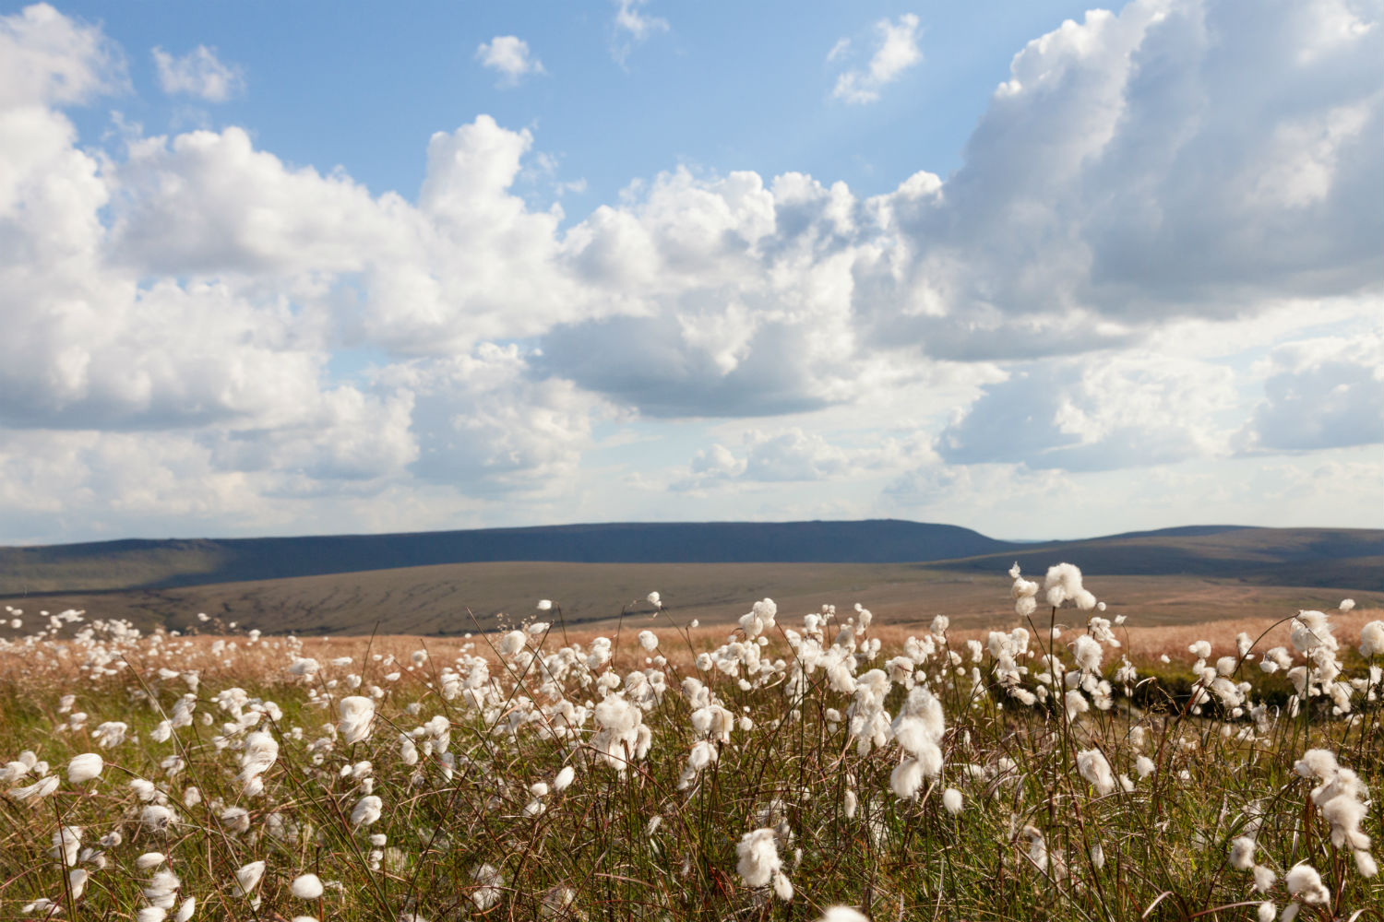
Conclusions
United Kingdom is one of the countries leading the way in restoring peatlands
Projects across the UK are delivering often large scale, restoration and rewetting of peatlands
Government commitments to secure future of this peatlands
And yet…
80% of our UK peatlands are still in a damaged state
There are conflicts between peatland restoration and some subsidy-based land management practices
We are in a time of significant policy change post-Brexit
Notes:
The case for restoration and rewetting of peatland is strong.
the United Kingdom is ones of the countries leading the way in restoring peatlands, and setting commitment to secure their future of this important part of our natural environment.
Yet most peatland in the UK is in degraded and declining condition, resulting in risk to the full range of functions it serves and the release of tons of carbon emission every year.
This workshop comes at a time of significant changes in the UK as the country detangles itself from the European Union and the Common Agricultural Policy.
the presentation that follows mine, by the IUCN UK peatland programme, will review whether the existing strategies and actions are enough – setting the scene, for the discussion where you all will help identify the gaps between where we are now and where we want to be, and the actions we should take.

